Slide 1
Session 12
Spring MVC with JDBC

Slide 2
Spring MVC and JDBC
Spring makes it easy to work with JDBC through the use of JdbcTemplate and related classes in the org.springframework.jdbc.core and related packages.
This tutorial is demonstrating how to integrate JdbcTemplate in a Spring MVC application.
The sample application in this tutorial manages a contact list that looks like this: Contact list Spring MVC JdbcTemplate
The sample application is developed using the following technologies (you can use newer versions):
Java 7
Eclipse
Spring framework 4.0
JSTL 1.2
MySQL Database 5.5
Maven 3

Slide 3
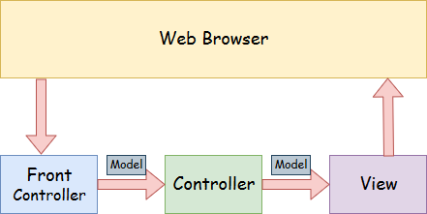
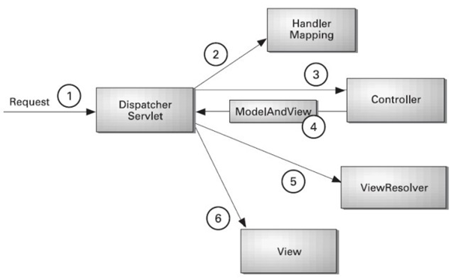
Spring MVC control flow

Slide 4
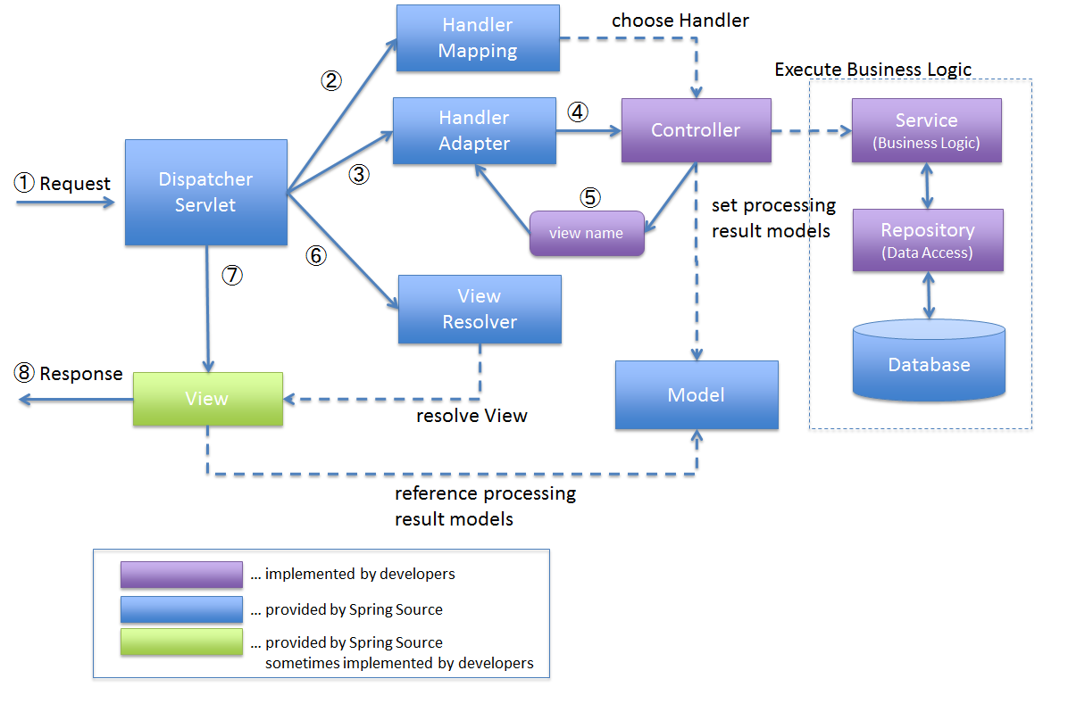
Spring MVC architecture

Slide 5
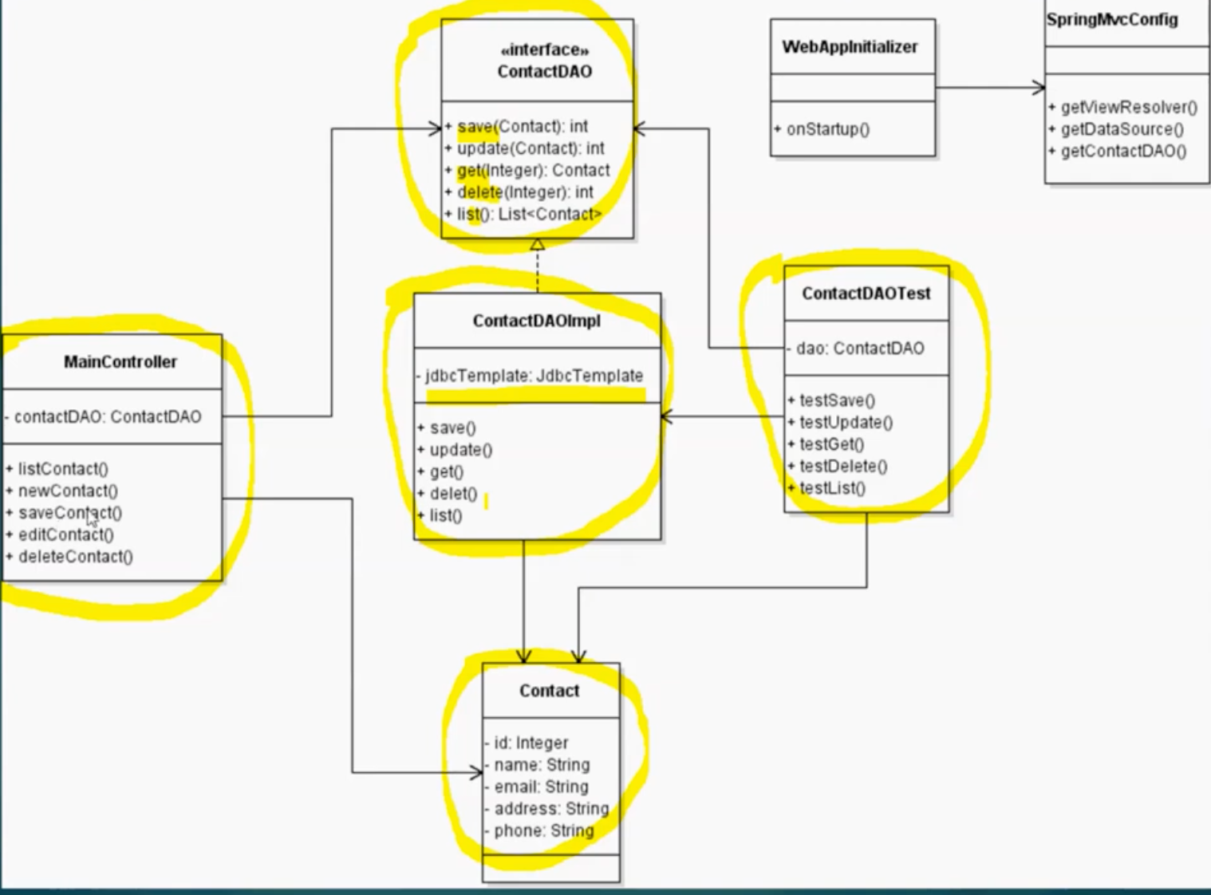
Class Diagram

Slide 6
1. Creating MySQL database table
Execute the following MySQL script to create a database named student and a table named contact:
CREATE TABLE `contact` ( `contact_id` int(11) NOT NULL AUTO_INCREMENT, `name` varchar(45) NOT NULL, `email` varchar(45) NOT NULL, `address` varchar(45) NOT NULL, `telephone` varchar(45) NOT NULL, PRIMARY KEY (`contact_id`) )

Slide 7
2. Creating Maven Project in Eclipse
It’s recommended to use spring-mvc-archetype to create the project (See: Creating a Spring MVC project using Maven and Eclipse in one minute). Here’s the project’s final structure: Spring MVC JDBC Project structure The following XML section in pom.xml file is for adding dependencies configuration to the project: <properties> <java.version>1.7</java.version> <spring.version>4.0.3.RELEASE</spring.version> <cglib.version>2.2.2</cglib.version> </properties> <dependencies> <!-- Spring core & mvc --> <dependency> <groupId>org.springframework</groupId> <artifactId>spring-context</artifactId> <version>${spring.version}</version> </dependency> <dependency> <groupId>org.springframework</groupId> <artifactId>spring-webmvc</artifactId> <version>${spring.version}</version> </dependency> <dependency> <groupId>org.springframework</groupId> <artifactId>spring-orm</artifactId> <version>${spring.version}</version> <type>jar</type> <scope>compile</scope> </dependency> <!-- CGLib for @Configuration --> <dependency> <groupId>cglib</groupId> <artifactId>cglib-nodep</artifactId> <version>${cglib.version}</version> <scope>runtime</scope> </dependency> <!-- Servlet Spec --> <dependency> <groupId>javax.servlet</groupId> <artifactId>javax.servlet-api</artifactId> <version>3.1.0</version> <scope>provided</scope> </dependency> <dependency> <groupId>javax.servlet.jsp</groupId> <artifactId>javax.servlet.jsp-api</artifactId> <version>2.3.1</version> <scope>provided</scope> </dependency> <dependency> <groupId>jstl</groupId> <artifactId>jstl</artifactId> <version>1.2</version> </dependency> </dependencies>

Slide 8
3. Coding Model Class
The model class - Contact.java : package net.codejava.spring.model; public class Contact { private int id; private String name; private String email; private String address; private String telephone; public Contact() { } public Contact(String name, String email, String address, String telephone) { this.name = name; this.email = email; this.address = address; this.telephone = telephone; } // getters and setters } This class simply maps a row in the table contact to a plain old Java object (POJO) - Contact.

Slide 9
4. Coding DAO Classes
The ContactDAO interface defines methods for performing CRUD operations on the contact table: package net.codejava.spring.dao; import java.util.List; import net.codejava.spring.model.Contact; / * Defines DAO operations for the contact model. * @author www.codejava.net * */ public interface ContactDAO { public void saveOrUpdate(Contact contact); public void delete(int contactId); public Contact get(int contactId); public List<Contact> list(); }

Slide 10
Implementation - ContactDAOImpl.java:
package net.codejava.spring.dao; import java.sql.ResultSet; import java.sql.SQLException; import java.util.List; import javax.sql.DataSource; import net.codejava.spring.model.Contact; import org.springframework.dao.DataAccessException; import org.springframework.jdbc.core.JdbcTemplate; import org.springframework.jdbc.core.ResultSetExtractor; import org.springframework.jdbc.core.RowMapper; public class ContactDAOImpl implements ContactDAO { private JdbcTemplate jdbcTemplate; public ContactDAOImpl(DataSource dataSource) { jdbcTemplate = new JdbcTemplate(dataSource); } @Override public void saveOrUpdate(Contact contact) { // implementation details goes here... } @Override public void delete(int contactId) { // implementation details goes here... } @Override public List<Contact> list() { // implementation details goes here... } @Override public Contact get(int contactId) { // implementation details goes here... } }

Slide 11
Pay attention to the beginning section that declares a JdbcTemplate and a DataSource object is injected via the constructor:
private JdbcTemplate jdbcTemplate; public ContactDAOImpl(DataSource dataSource) { jdbcTemplate = new JdbcTemplate(dataSource); } Now, let’s look at implementation details of each method. Insert or update a new contact: public void saveOrUpdate(Contact contact) { if (contact.getId() > 0) { // update String sql = "UPDATE contact SET name=?, email=?, address=?, " + "telephone=? WHERE contact_id=?"; jdbcTemplate.update(sql, contact.getName(), contact.getEmail(), contact.getAddress(), contact.getTelephone(), contact.getId()); } else { // insert String sql = "INSERT INTO contact (name, email, address, telephone)" + " VALUES (?, ?, ?, ?)"; jdbcTemplate.update(sql, contact.getName(), contact.getEmail(), contact.getAddress(), contact.getTelephone()); } } Note that if the contact object having ID greater than zero, update it; otherwise that is an insert. NOTE: For more code readability, you can use NamedParameterJdbcTemplate, instead of using question marks (?) as placeholders. Also you can use SimpleJdbcInsert class which is more convenient to use.

Slide 12
Delete a contact:
public void delete(int contactId) { String sql = "DELETE FROM contact WHERE contact_id=?"; jdbcTemplate.update(sql, contactId); }

Slide 13
List all contact:
public List<Contact> list() { String sql = "SELECT * FROM contact"; List<Contact> listContact = jdbcTemplate.query(sql, new RowMapper<Contact>() { @Override public Contact mapRow(ResultSet rs, int rowNum) throws SQLException { Contact aContact = new Contact(); aContact.setId(rs.getInt("contact_id")); aContact.setName(rs.getString("name")); aContact.setEmail(rs.getString("email")); aContact.setAddress(rs.getString("address")); aContact.setTelephone(rs.getString("telephone")); return aContact; } }); return listContact; }

Slide 14
Notice the use of RowMapper to map a row in the result set to a POJO object. For more convenient, you can use the BeanPropertyRowMapper class like this: public List<Contact> list() { String sql = "SELECT * FROM Contact"; return jdbcTemplate.query(sql, BeanPropertyRowMapper.newInstance(Contact.class)); } Make sure that the Contact class declare the field names exactly match the column names in the database table. Using BeanPropertyRowMapper is more convenient, but performance is slower than using RowMapper.

Slide 15
Get a particular contact:
public Contact get(int contactId) { String sql = "SELECT * FROM contact WHERE contact_id=" + contactId; return jdbcTemplate.query(sql, new ResultSetExtractor<Contact>() { @Override public Contact extractData(ResultSet rs) throws SQLException, DataAccessException { if (rs.next()) { Contact contact = new Contact(); contact.setId(rs.getInt("contact_id")); contact.setName(rs.getString("name")); contact.setEmail(rs.getString("email")); contact.setAddress(rs.getString("address")); contact.setTelephone(rs.getString("telephone")); return contact; } return null; } }); }

Slide 16
Notice the use of ResultSetExtractor to extract a single row as a POJO. You can also use the BeanPropertyRowMapper class like this:
public Contact get(int contactId) { String sql = "SELECT * FROM Contact WHERE id=" + contactId; return jdbcTemplate.queryForObject(sql, BeanPropertyRowMapper.newInstance(Contact.class)); } It greatly simplifies the code, but in return of slower performance.

Slide 17
5. Coding Spring MVC Configuration
Java-based classes and annotations are used to configure this Spring MVC application. Here’s code of the MvcConfiguration class: package net.codejava.spring.config; import javax.sql.DataSource; import net.codejava.spring.dao.ContactDAO; import net.codejava.spring.dao.ContactDAOImpl; import org.springframework.context.annotation.Bean; import org.springframework.context.annotation.ComponentScan; import org.springframework.context.annotation.Configuration; import org.springframework.jdbc.datasource.DriverManagerDataSource; import org.springframework.web.servlet.ViewResolver; import org.springframework.web.servlet.config.annotation.EnableWebMvc; import org.springframework.web.servlet.config.annotation.ResourceHandlerRegistry; import org.springframework.web.servlet.config.annotation.WebMvcConfigurerAdapter; import org.springframework.web.servlet.view.InternalResourceViewResolver; @Configuration @ComponentScan(basePackages="net.codejava.spring") @EnableWebMvc public class MvcConfiguration extends WebMvcConfigurerAdapter{ @Bean public ViewResolver getViewResolver(){ InternalResourceViewResolver resolver = new InternalResourceViewResolver(); resolver.setPrefix("/WEB-INF/views/"); resolver.setSuffix(".jsp"); return resolver; } @Override public void addResourceHandlers(ResourceHandlerRegistry registry) { registry.addResourceHandler("/resources/").addResourceLocations("/resources/"); } @Bean public DataSource getDataSource() { DriverManagerDataSource dataSource = new DriverManagerDataSource(); dataSource.setDriverClassName("com.mysql.jdbc.Driver"); dataSource.setUrl("jdbc:mysql://localhost:3306/contactdb"); dataSource.setUsername("root"); dataSource.setPassword("P@ssw0rd"); return dataSource; } @Bean public ContactDAO getContactDAO() { return new ContactDAOImpl(getDataSource()); } } Notice the getDataSource() method returns a configured DataSource bean. You may have to change the database URL, username and password according to your environments. The getContactDAO() method returns an implementation of the ContactDAO interface, which is the ContactDAOImpl class. This bean will be injected to the controller class, which is described below.

Slide 18
6. Configuring Spring MVC Dispatcher Servlet
And to enable Spring MVC for our Java web application, update the web deployment descriptor file (web.xml) as below: <?xml version="1.0" encoding="UTF-8"?> <web-app version="2.4" xmlns="http://java.sun.com/xml/ns/j2ee" xmlns:xsi="http://www.w3.org/2001/XMLSchema-instance" xsi:schemaLocation="http://java.sun.com/xml/ns/j2ee http://java.sun.com/xml/ns/j2ee/web-app_2_4.xsd"> <display-name>SpringMvcJdbcTemplate</display-name> <context-param> <param-name>contextClass</param-name> <param-value> org.springframework.web.context.support.AnnotationConfigWebApplicationContext </param-value> </context-param> <listener> <listener-class>org.springframework.web.context.ContextLoaderListener</listener-class> </listener> <servlet> <servlet-name>SpringDispatcher</servlet-name> <servlet-class>org.springframework.web.servlet.DispatcherServlet</servlet-class> <init-param> <param-name>contextClass</param-name> <param-value> org.springframework.web.context.support.AnnotationConfigWebApplicationContext </param-value> </init-param> <init-param> <param-name>contextConfigLocation</param-name> <param-value>net.codejava.spring</param-value> </init-param> <load-on-startup>1</load-on-startup> </servlet> <servlet-mapping> <servlet-name>SpringDispatcher</servlet-name> <url-pattern>/</url-pattern> </servlet-mapping> <session-config> <session-timeout>30</session-timeout> </session-config> </web-app>

Slide 19
7. Coding Spring Controller Class
Skeleton of the HomeController class: public class HomeController { @Autowired private ContactDAO contactDAO; // handler methods go here... } Notice we use the @Autowired annotation to let Spring inject an instance of the ContactDAO implementation into this controller automatically. Each handler method uses this contactDAO object to perform necessary CRUD operations. Let’s see implementation details of each method.

Slide 20
Handler method for listing all contacts (also served as home page):
@RequestMapping(value="/") public ModelAndView listContact(ModelAndView model) throws IOException{ List<Contact> listContact = contactDAO.list(); model.addObject("listContact", listContact); model.setViewName("home"); return model; } Handler method for displaying new contact form: @RequestMapping(value = "/newContact", method = RequestMethod.GET) public ModelAndView newContact(ModelAndView model) { Contact newContact = new Contact(); model.addObject("contact", newContact); model.setViewName("ContactForm"); return model; } Handler method for inserting/updating a contact: @RequestMapping(value = "/saveContact", method = RequestMethod.POST) public ModelAndView saveContact(@ModelAttribute Contact contact) { contactDAO.saveOrUpdate(contact); return new ModelAndView("redirect:/"); }

Slide 21
Handler method for deleting a contact:
@RequestMapping(value = "/deleteContact", method = RequestMethod.GET) public ModelAndView deleteContact(HttpServletRequest request) { int contactId = Integer.parseInt(request.getParameter("id")); contactDAO.delete(contactId); return new ModelAndView("redirect:/"); }

Slide 22
Handler method for retrieving details of a particular contact for editing:
@RequestMapping(value = "/editContact", method = RequestMethod.GET) public ModelAndView editContact(HttpServletRequest request) { int contactId = Integer.parseInt(request.getParameter("id")); Contact contact = contactDAO.get(contactId); ModelAndView model = new ModelAndView("ContactForm"); model.addObject("contact", contact); return model; }

Slide 23
8. Coding Contact Listing Page (Home Page)
Here’s source code of the home.jsp page that displays the contact list as well as action links for creating new, editing and deleting a contact. <%@page contentType="text/html" pageEncoding="UTF-8"%> <!DOCTYPE HTML PUBLIC "-//W3C//DTD HTML 4.01 Transitional//EN" "http://www.w3.org/TR/html4/loose.dtd"> <%@ taglib uri="http://java.sun.com/jsp/jstl/core" prefix="c" %> <html> <head> <meta http-equiv="Content-Type" content="text/html; charset=UTF-8"> <title>Contact Manager Home</title> </head> <body> <div align="center"> <h1>Contact List</h1> <h3><a href="/newContact">New Contact</a></h3> <table border="1"> <th>No</th> <th>Name</th> <th>Email</th> <th>Address</th> <th>Telephone</th> <th>Action</th> <c:forEach var="contact" items="${listContact}" varStatus="status"> <tr> <td>${status.index + 1}</td> <td>${contact.name}</td> <td>${contact.email}</td> <td>${contact.address}</td> <td>${contact.telephone}</td> <td> <a href="/editContact?id=${contact.id}">Edit</a> &nbsp;&nbsp;&nbsp;&nbsp; <a href="/deleteContact?id=${contact.id}">Delete</a> </td> </tr> </c:forEach> </table> </div> </body> </html> Notice this JSP page uses JSTL and EL expressions.

Slide 24
9. Coding Contact Form Page
The contact form page (ContactForm.jsp) displays details of a contact for creating new or updating old one. Here’s its full source code: <%@ page language="java" contentType="text/html; charset=UTF-8" pageEncoding="UTF-8"%> <%@ taglib prefix="form" uri="http://www.springframework.org/tags/form"%> <!DOCTYPE html PUBLIC "-//W3C//DTD HTML 4.01 Transitional//EN" "http://www.w3.org/TR/html4/loose.dtd"> <html> <head> <meta http-equiv="Content-Type" content="text/html; charset=UTF-8"> <title>New/Edit Contact</title> </head> <body> <div align="center"> <h1>New/Edit Contact</h1> <form:form action="saveContact" method="post" modelAttribute="contact"> <table> <form:hidden path="id"/> <tr> <td>Name:</td> <td><form:input path="name" /></td> </tr> <tr> <td>Email:</td> <td><form:input path="email" /></td> </tr> <tr> <td>Address:</td> <td><form:input path="address" /></td> </tr> <tr> <td>Telephone:</td> <td><form:input path="telephone" /></td> </tr> <tr> <td colspan="2" align="center"><input type="submit" value="Save"></td> </tr> </table> </form:form> </div> </body> </html> Notice that this JSP page uses Spring form tags to bind the values of the form to a model object.

Slide 25
To test out the application, you can download the Eclipse project or deploy the attached WAR file at your convenience. Open in browser http://localhost:8080/SpringMvcJdbcTemplate/

Slide 26
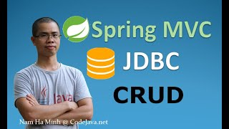
References
https://www.codejava.net/frameworks/spring/spring-mvc-with-jdbctemplate-example

